Slide 1

Best Place for Business in Haiti
Author : David Louis
September
2021

Slide 2
Agenda
Introduction
Methodology
EDA
Model
Recommandation

Slide 3
Introduction
Business Location Analysis is a technique for discovering,
assessing and specifying the optimal placement
to start or to expand business activities.
The location of a business has a significant impact on its future,
It is essential to choose the right location
to ensure that it is convenient for customers
and that there is sufficient demand in the area,
which makes deciding on the location of a business
a crucial step for any contractor
wanting to start or expand their business activities.

Slide 4
What Is The Best Municipality To Start Your Business? Or What Is The Next Location To Expand Your Business?

Slide 5
Stakeholders
Contractors
Customers

Slide 6
Methodology
Data cleaning
Data acquisition
Data analysis
Modeling
Conclusion

Slide 7
Data
Data Acquisition
Features Used
The list of businesses in the various sectors of activity by municipality.
Source: Web Scraping from www.pagespro.ht
The demographic data of the various municipalities.
Source: Office For The Coordination Of Humanitarian Affairs (OCHA)
Commune’s Name
Commune’s Geo-Location
Percentage of Men and Women
Wage Bill per municipality
Business’s location
Business’s sector activity

Slide 8
Data Visualization
Municipality
25
Business
5265
Business Line
28

Slide 9
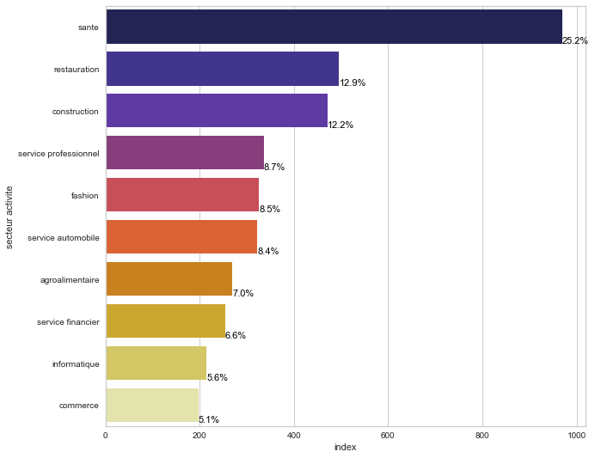
Top 10 business line in the country

Slide 10
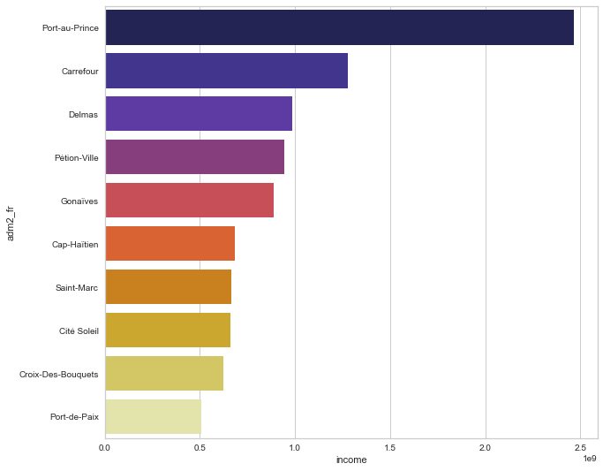
Top 10 Municipality
With the highest Wage Bill

Slide 11
Clustering Analysis
The machine learning model called "clustering" is used to group the data into different groups based on the similarities found and discover underlying patterns. To achieve this objective, K-means looks for a fixed number (k) of clusters in the dataset. The elbow method is used to determine the number of cluster which is (k).
K=3
The machine learning model will segmenting data by municipality based on business line and demographics such as gender distribution and Wage Bill.

Slide 12
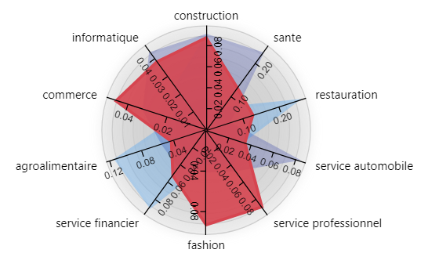
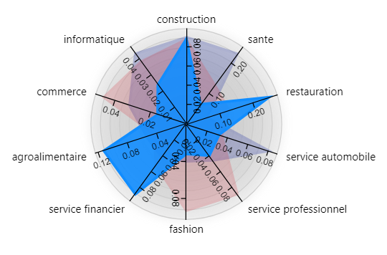
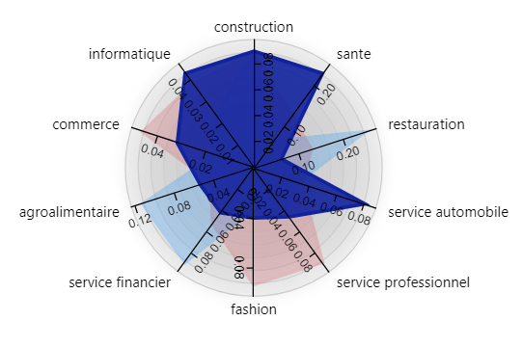
Cluster Analysis
Cluster 0
Cluster 1
Cluster 2

Slide 13
Cluster Analysis
Cluster 0
Cluster 1
Cluster 2
Cluster 0 is characterized by communes with a Wage Bill between 400 million and 1 billion gourdes.
Group 1 is characterized by communes that have a Wage Bill of less than or equal to 400 million gourdes.
Group 2 is characterized by 8.46% of communes with a Wage Bill of less than or equal to 400 million gourdes, 20.66% of communes with a Wage Bill between 400 million and 1 billion gourdes, and 70.86% of communes with a Wage Bill between 1 billion and 3 billion gourdes.

Slide 14
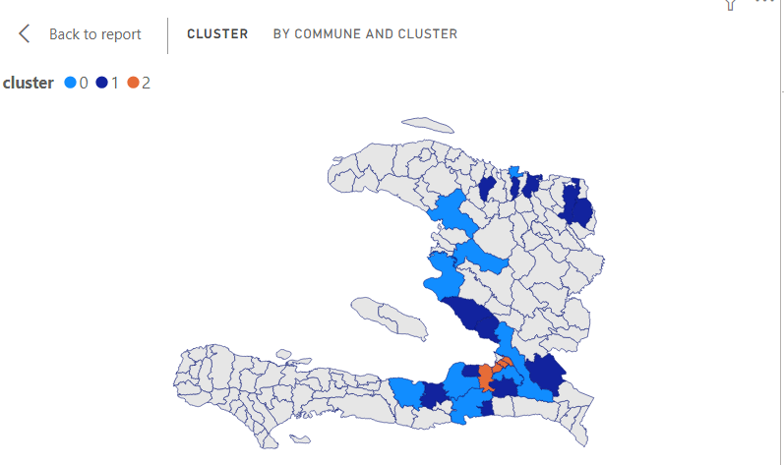
Cluster distribution
by municipality

Slide 15
Conclusion
Based on the data, the best cluster is Cluster 2.
It covers a whole population with incomes
ranging from 400 million to 3 billion gourdes.

Slide 16
Recommandation
Contractors who wish to start or develop their commercial activities
should target municipalities such as Port-au-Prince, Tabarre, Delmas and Carrefour

Slide 17

Thank you
David LOUIS
Téléphone
+509 4485-8714
E-mail
davidlouis301@yahoo.fr
GitHub Link
GitHub link to the project

